Slide 1


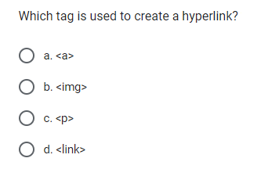

QUIZ
10 MIN
1
2
3
Fill up the
QUIZ FORM
Discuss
Group of 3
Update your answers
If you need

Slide 2
CHAPTER 1
HYPERLINK

Slide 3

OBJECTIVES FOR TODAY
Be able to define a link between pages using an anchor
Make the difference between absolute and relative path
Be able to define the right path to get a resource

Slide 4

GAME
GOAL:
You will find the correct destination for your file with the path.
30 MIN
6
What is a path of file.html?
Ex : Root/Box3/Box2/Box1/file.html
How to go to file.html?
First you can start from Root
Then Box3
Box2
Box1
Finally you got file.html
File.html
Box 1
Box 2
Box 3
Root
If I am in File.html how can I go the previous Box?
../ if I want to go to Box1
../../ if I want to go to Box2
../../../../ if I want to go to Root
../../../ where should I go?

Slide 5

EXPLORE
SHARE
Think | Search
20 MIN
What is a hyperlink ?
How to create a hyperlink in HTML ?
Why hyperlinks change color once we click on them ?
Code
10 MIN
Code a link to another HTML file
Code a link to Google website
Share
10 MIN
Present your solution of 3 other people
Which points do you agree , disagree ?

Slide 6

EXPLAIN
The <a> (anchor)
10 MIN
CLASS
The <a> tag defines a hyperlink, which is used to link from one page to another.
<a href=“../file.html”>Click me</a>
href = hyperlink reference
The link to another file
What is displayed on the page

Slide 7
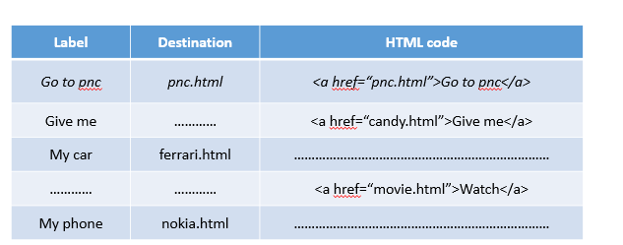
PRACTICE
ACTIVITY 1
10 MIN
1
Complete exercise in your handout | MISSING ATTRIBUTES – Practice

Slide 8
EXPLAIN
Absolute or Relative path
10 MIN
CLASS
Absolute path
The path start
from the root
<a href="http://www.google.com">Go to Google</a>
<a href="../hometown.html">Go to hometown</a>
Relative path
The path start
from where you are
<a href="folder/hometown.html">Go to hometown</a>
Notes:
Explain / and .. and http

Slide 9
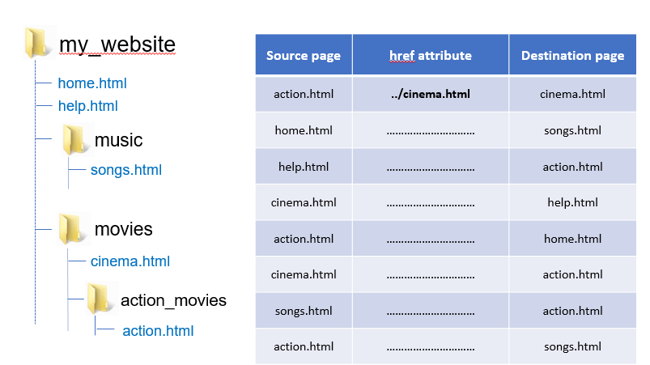
PRACTICE
ACTIVITY 2
10 MIN
1
Complete exercise in your handout | RELATIVE LINKS - PRACTICE

Slide 10

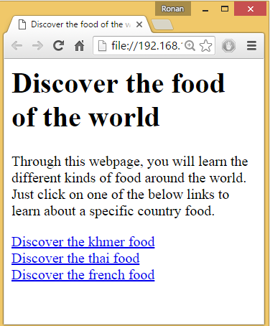

PRACTICE
ACTIVITY 3
1
Create the missing HTML file and complete the links
foods
Food.html
thai
Thai.html
khmer
Khmer.html
french
french.html

Slide 11


HOMEWORK
After class what to do ?
INDIV
1. Complete the handout I give you now.
2. Do the required homeworks
3. Send your homework to Google Classroom

